Slide 1
Insights from social media presence Project Proposal for The Data Incubator Fellowship
By: Muluemebet G Ayalew
August, 2019
Boston, MA

Slide 2
About me
Project proposal

Slide 3
About me
Education : MS in Industrial Engineering , MS in Engineering and Policy Analysis
Work Experience:
More than 3 years experience in teaching and researching, taught statistics and engineering courses at Mekelle University,
teaching fellow at Harvard Extension School, Harvard University since Aug, 2017- taught and assisted python programming course.

Slide 4
Project Proposal
Data:
I am planning to work on ”Facebook Followers dataset” and more.
The date contains information about company name, number of check-ins for specific day, were- here -counts, likes and talking about counts
The project can help companies to understand their social-media share, how relevant is this share and how to increase it, what the talk about them implies, do this all affect their stock price. All this information can be used for marketing and strategic planning and allow them to play better in the market.

Slide 5
Cont.
Objective : is to maximize the benefits of social media presence
Research Questions
What the trend looks like, which month gets most number
Share compared to competitors
Which variables are relevant to predict stock price
Does the talk about a company has positive or negative sentiment?

Slide 6
Potential stakeholders benefited by the analysis
Facebook, social media service provider
Add more features that provide statistics about companies social media share
Add premium option to get more info about competitor, make company recommendation
Companies : know more about their social media share, competitors , get input for strategic planning (what to do to increase the share, when is a good time for marketing/promotion)
Job seekers: which month is good to consider an industry (looking employee on platform) , (doubled in IT and service industry and ,5 times in banking) sept and oct

Slide 7
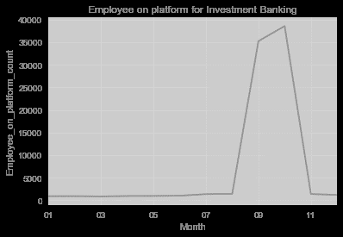

Slide 8
Methodology
Approach : data exploration , data analysis and visualization
Modeling (regression, clustering and sentiment analysis )
Tool :
python (panda, matplotlib, seaborn, numpy, scikitlearn)

Slide 9
Potential data sources
Facebook followers(The Data Incubator and Thinknum)
Linkedin (The Data Incubator and Thinknum )
US companies repository(https://www.uscompanieslist.com/)
Stock price market (yahoo finance or other)

